Slide 1

Thread
Lecturer: VU THI MY HANG
Operating System

Slide 2
Plan
Thread Concepts
Thread Models
Thread Management

Slide 3
Plan
Thread Concept
Thread Models
Thread Management

Slide 4
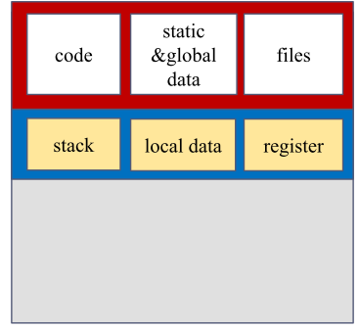
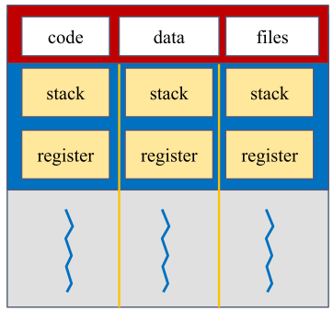

What is a Thread?
Thread Concept
Thread: an execution line within a process (i.e., a lightweight process)
A process is divided into different parts (threads)
Threads belonging to a process can execute concurrently
Single-threaded process
Multi-threaded process

Slide 5


Purpose
Thread Concept
Process perform various tasks (threads of execution) simultaneously
Especially efficient on multiprocessor or multicore systems
P_{browser}
P_{browser}
Display webpage
Download file ABC
Display webpage
Download file ABC
Core
Core
Multiprocessor system
Multicore system

Slide 6
Benefits
Thread Concept
Responsiveness
If a thread of a process is blocked or time-consuming, other parts of the process still can continue their jobs
Resources sharing
Threads belonging to the same process share the same address space
Economy
Less cost of thread creation and management
Scalability
Threads can be executed on different cores/processors

Slide 7
Plan
Thread Concept
Thread Models
Thread Management

Slide 8
Thread-level Implementation
Thread Models
P
P
P
User space
Kernel space
Thread
Library
k
k
k
User space
Kernel space
Thread
Library
User space
Kernel space
k
k
P
P
P
User-level thread
k
Kernel-level thread
Hybrid thread
Supported in user space
Supported in kernel space
Supported in both user and kernel space

Slide 9
User-level Threads
Thread Models
Implemented by user thread libraries (i.e., APIs supported by programming languages) in user space with no kernel support
☺ Be efficient
Thread management, context switching, and synchronization done without any OS intervention
☺ Do not need system support
The kernel knows nothing about user threads
Entire process will be blocked if one of its threads is blocked
Timesharing system: giving the same amount of time to each process for execution ➔ Fairness when P1 having 10 threads and P2 having 1000 threads?

Slide 10
Kernel-level Threads
Thread Models
Supported directly by OS and implemented in kernel space
☺ OS manages thread
When a thread of a process is blocked, other parts of the process can continue to execute independently
Slower and less efficient
Thread management, context switching, and synchronization require OS intervention

Slide 11
Kernel-level and User-level Thread Mapping
Thread Models
Many-to-one model
Many-to-many model
User
space
Kernel
space
User
space
Kernel
space
k
k
k
One-to-one model
Two-level model
User
space
Kernel
space
User
space
Kernel
space
k
k
k
k
k
k

Slide 12
Plan
Thread Concept
Thread Models
Thread Management

Slide 13
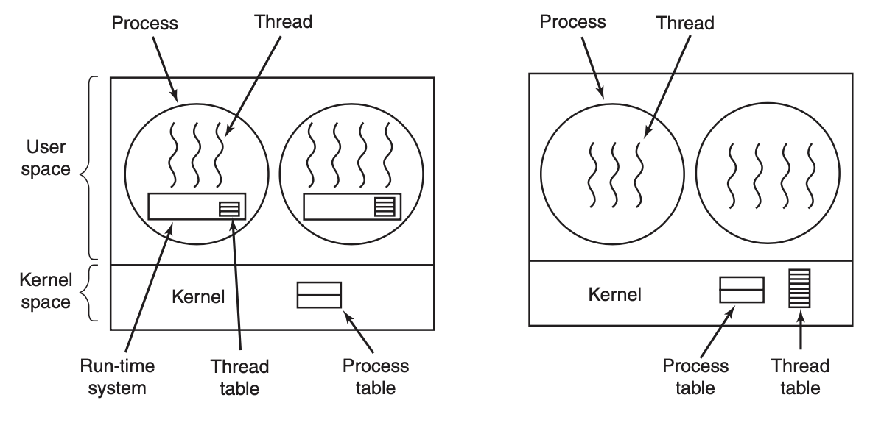
User-level vs. Kernel-level Management
Thread Management
User-level thread Management
Kernel-level thread Management

Slide 14
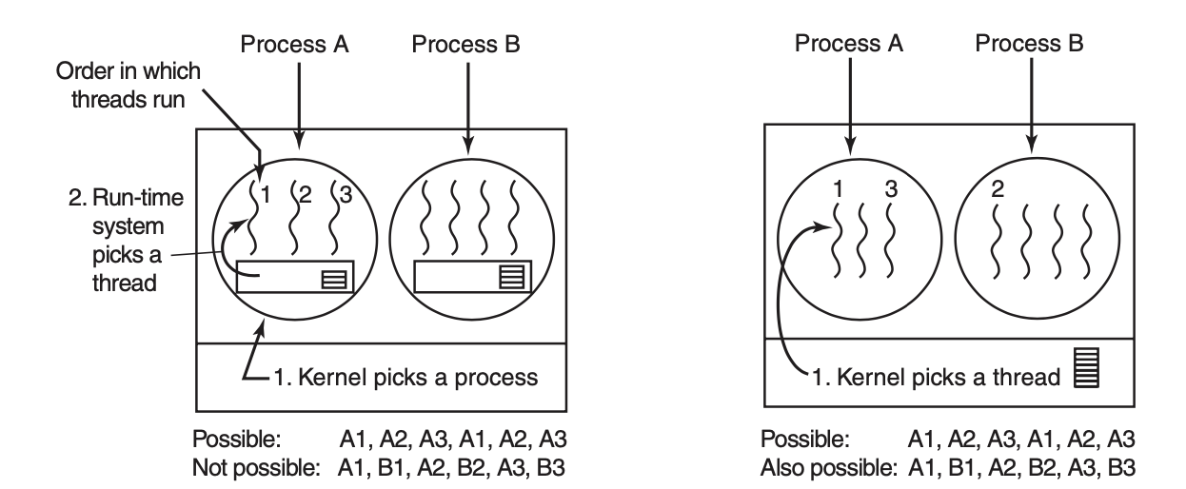
Thread Scheduling
Thread Management
User-level thread Scheduling
Kernel-level thread Scheduling

Slide 15
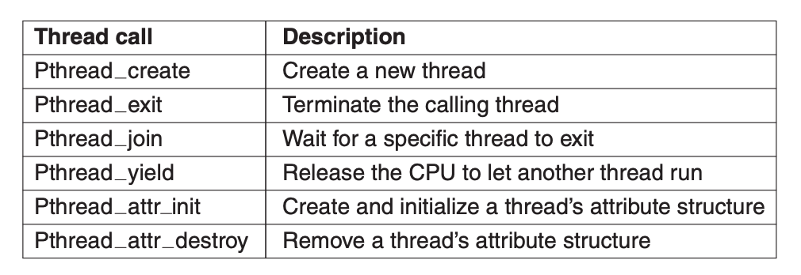
Thread Libraries
Thread Management
Provide APIs for thread creation and management
POSIX thread (Pthread): support both user and kernel thread libraries
Windows thread: support kernel threads managed directly by Windows
Java thread: support Java thread programming
Some of Pthread functions

Slide 16

Topic 1

